Slide 1
Arduino Workshop #2
Digital Inputs, Outputs, and Pulse Width Modulation
Notes:
24 - Arduino Uno
24 - small bread board
24 - sets of jumper wires
24 - 10 kΩ resistors
72 - 220 Ω resistors
24 - USB cables
24 - push buttons
24 - 5mm single color LED
24 - 5mm common cathode RGB LED

Slide 2
Digital Outputs

Slide 3
Working with breadboards
Today we are going to learn how to make and use external circuits
To do this we will use breadboard to prototype circuits

Slide 4
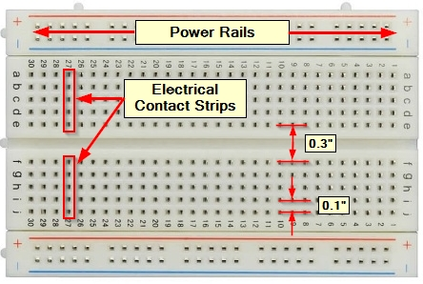
What is a breadboard?
Pros:
Inexpensive and easy to get up and running
Circuits can be constructed easily and quickly
Wires can also be used to connect that circuit to a microcontroller
No soldering is required.
Changes to the circuit can be made easily
Can be easily removed and reused in a new circuit in the future.

Slide 5
Wiring LED’s
LEDs (light emitting diodes) will be heavily used
LED’s are
Polarized
Direction of connection matters
The flat side or shorter lead is the cathode (negative lead)
The positive lead is the anode
Need a resistor in series (on either the positive or negative side)
Too much current can damage the Arduino
We will use 220 Ω resistors

Slide 6
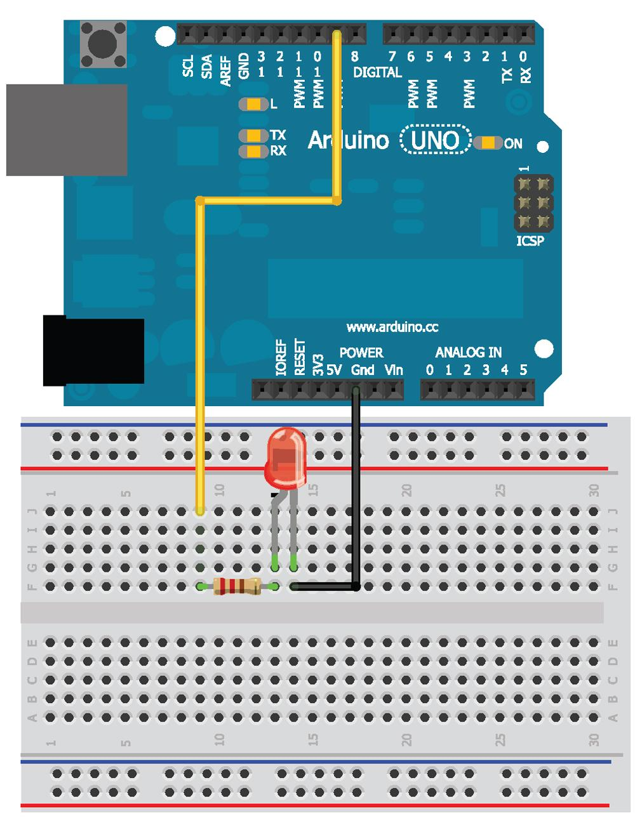
Let's wire up the Circuit

Slide 7
Ohm's Law
Voltage (V) represents electrical potential
Current (I) flows from high potential to low potential
Resistance (R) is the “ease” of flow
Ohms law states:
V = I R
All voltage is “used” in a circuit
LED’s have a predefined voltage drop across them
Need a particular current
Max of 20 mA
Thus we see
2 volts/(20 mA) = 150 Ω
As resistance increases -- current drops
We use 220 Ω to insure the max amperage is not exceeded (safety factor)

Slide 8
Power Equation
We also know the power equation
P = I V
Power is the current times the voltage
Resistor’s have a power rating of
1/4 W (250 mW)
P = 3 V *0.02 A = 60 mW
Which is less than 250 mW

Slide 9
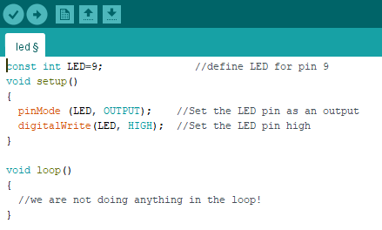
Programming digital outputs
Upload this to turn on the LED

Slide 10
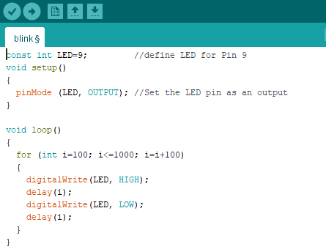
Using For Loops
For loops
Used to repeat a process a set number of times
Upload this to blink the LED from fast to slow.

Slide 11
How it works
First entry sets index variable for the loop (i is set to start at 100)
The second entry decides when the loop should stop
The loop will execute over and over
while i < = (less than or equal to) 1000
The final entry specifies what should happen to the index at the end of each loop
i is set to the current value plus 100

Slide 12
Pulse Width Modulation with AnalogWrite()

Slide 13
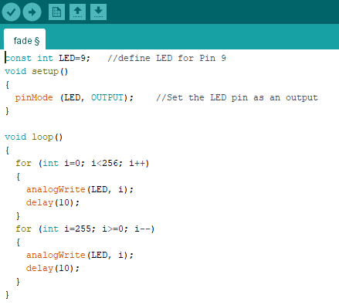
Pulse Width Modification (PWM)
We can’t get analog outputs
But we can get close with pulse-Width modification (PWM) and the analogWrite() comand

Slide 14
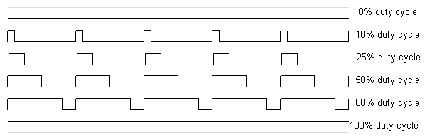
PWM - what's actually happening?
PWM works by modulating the “duty cycle” (the percentage of time the voltage is high vs. low)
The analogWrite() command sets the duty cycle depending on the value you pass it
0 -- always off
225 -- always on
127 -- 50% cycle
YOU NEVER CHANGE THE VOLTAGE

Slide 15
Reading Digital Inputs

Slide 16
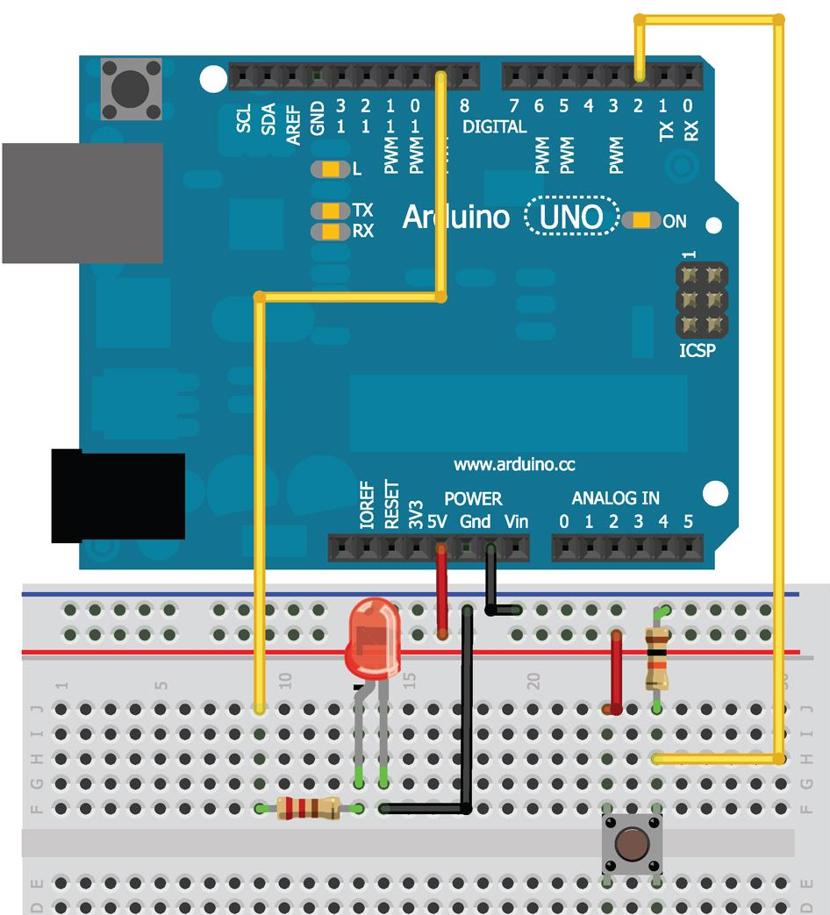
Wire diagram

Slide 17
Pull down resistor
Notice the resistor running from the button to the ground
This is a pull down resistor
5 v can run two paths
When the button is not being pressed it runs through the resistor to ground
When the button is pressed it runs through the button to ground
This insures that
The button does not create a short
The input pin is never in a floating state

Slide 18
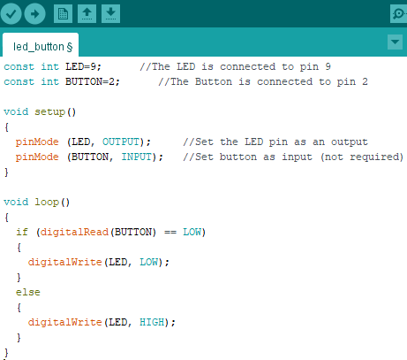
Let's look at the code
Notice:
If button is
Pressed
digitalRead() returns HIGH
Not being pressed
digitalRead() returns LOW
When did you have to last hold the button down to keep a light on?
Define a state for the switch
Change state

Slide 19
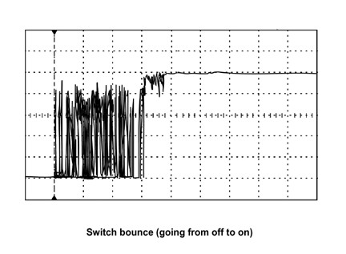
Bouncy buttons
Bouncy button mean when you press the button the volatge bounces up and down before it settles to the high state.
This would turn something on and off several times.
We can program a small delay to help combat this issue.

Slide 20
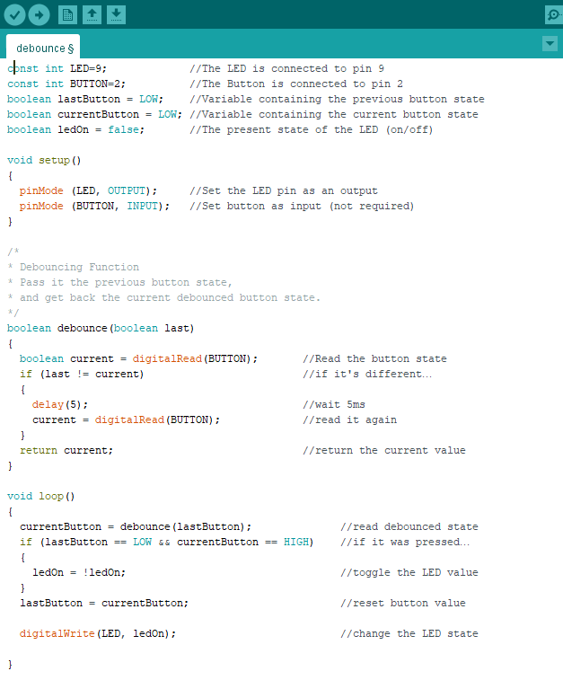
Code to do this

Slide 21
How it works
Stores the state of the button
Initialized to LOW
Reads the current state
If the current state differs from the previous state
Waits 5 ms (button must have changed states)
Rereads the button and uses that as the current state
If the previous state was low and current state is high
Toggles the led state
Set the previous button state to the current button state
Repeats from step 2

Slide 22
Building a controllable RGB Night light

Slide 23
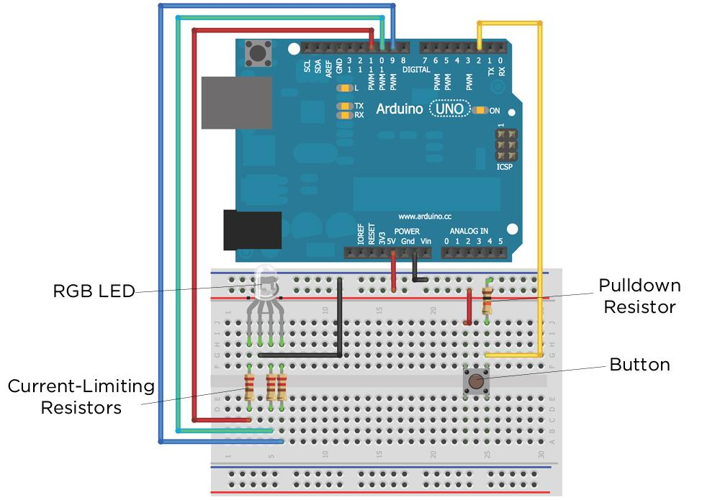
Diagram

Slide 24
Code
Download the RGB_nightlight.ino file from our GitHub page.

Slide 25
It may be alot….
But you have done all of it before, and you’ll see it again and again…

